Slide 1


Road Safety Strategy
find a copy at either: https://www.gov.uk/government/publications/road-safety-strategy
www.grahamfeest.com

Slide 2
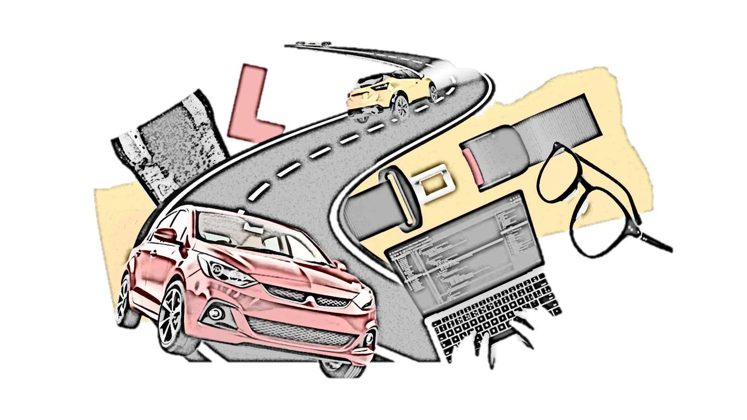
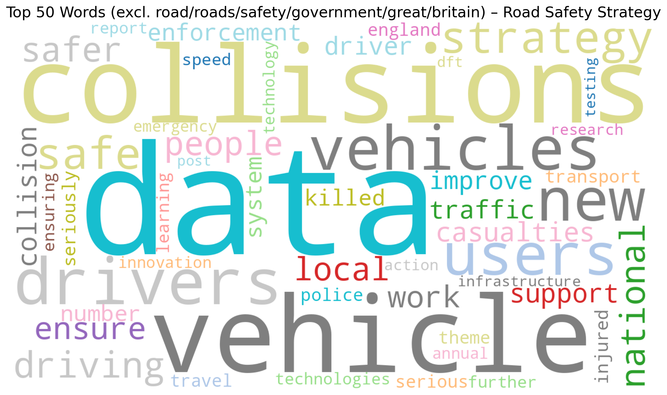
Road Safety Strategy

Slide 3
Road Safety Strategy
https://www.gov.uk/government/publications/road-safety-strategy
Targets
● 65% reduction in the number of people killed or seriously injured on roads in Great Britain by 2035, using a 2022-2024 baseline
● 70% reduction in the number of children (under 16) killed or seriously injured on roads in Great Britain by 2035, using a 2022-2024 baseline

Slide 4
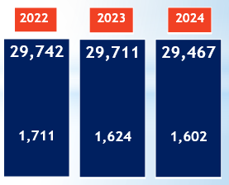
Road Safety Strategy
https://www.gov.uk/government/publications/road-safety-strategy
29,640
Average of baseline years
65% reduction would mean
10,374

Slide 5
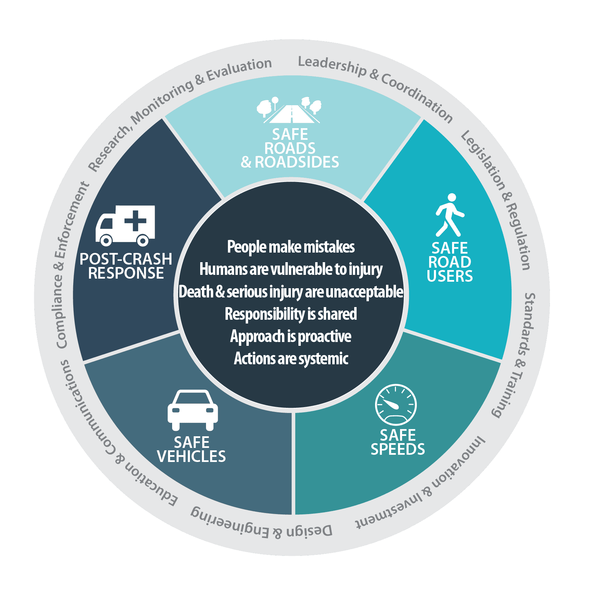

The Strategy is built on:
34 Action Points
Set out in four themes
Underpinned by the
safe system
supported by:
A case for change
A vision for the future
A commitment to deliver

Slide 6
Road Safety Strategy
Supporting Road Users
Taking Advantage of Technology, data and innovation for Safer Vehicles and Post Collision Care
Ensuring Infrastructure is Safe
Robust Enforcement to protect all Road Users

Slide 7
Road Safety Strategy
5 consultations have been launched
Motoring offences
Introducing a minimum learning period for learner drivers
(category B driving licence)
Introducing mandatory eyesight testing for older drivers
Improving moped and motorcycle training, testing and Licensing (categories AM, A1, A2 and A driving licence)
Mandating vehicle safety technologies in GB type approval

Slide 8
Road Safety Strategy
Immediate Key Takeaways
Introducing a minimum learning period for learner drivers
Introducing mandatory eyesight testing for older drivers
Improving moped and motorcycle training, testing and Licensing
Road Safety Investigation Branch
Life Long Learning for Road Users
Motoring Offences
Lowering the Drink Drive Limit
Penalty points for the Non Wearing of Seat Belts

Slide 9
Road Safety Strategy
https://www.gov.uk/government/publications/road-safety-strategy
www.grahamfeest.com

Slide 10
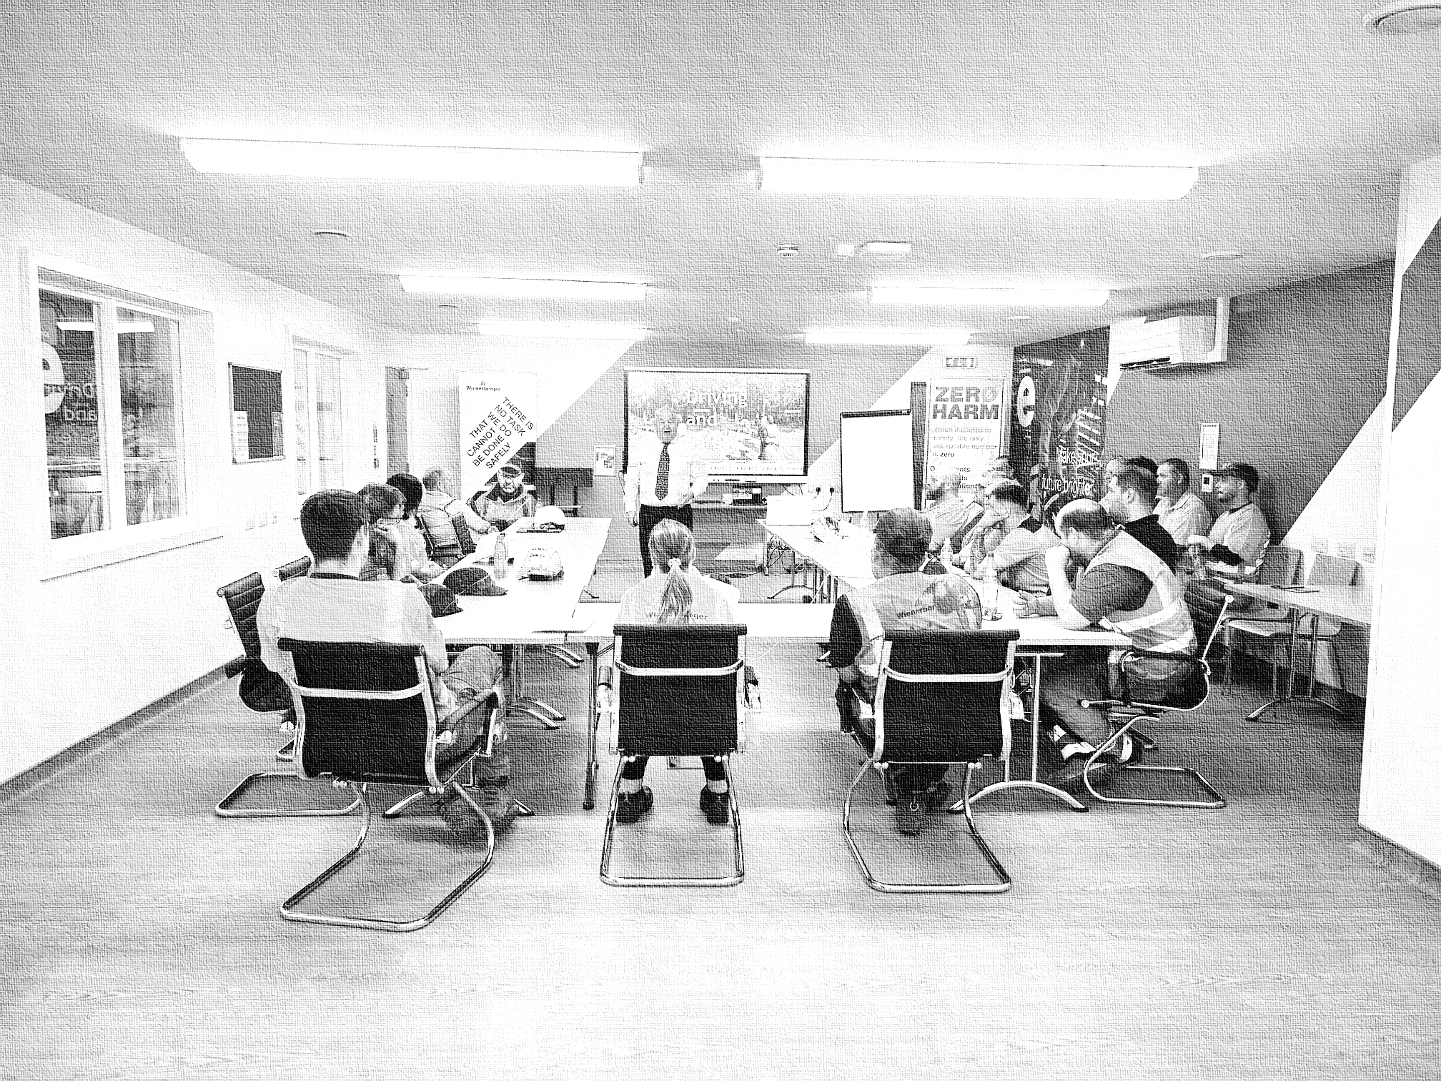







Graham Feest FAIRSO, F Inst IMTD, FARRM
Road Safety Consultant
5 Elgin Road, Worthing
West Sussex BN12 4PJ
07974 814116
graham@grahamfeest.com
www.grahamfeest.com
President
Institute of Master Tutors of Driving
Road Safety Advisor
Approved Driving Instructors National Joint Council
Road Safety Consultant
The RichWorks Ltd
Approved Training Provider for the Chartered Institute of Highways & Transportation

